Slide 1
Algorithms and their Applications CS2004 (2020-2021)
Dr Stephen Swift
S.1 Lab sheet 1 – Supplemental – Heron’s Algorithm

Slide 2


The Laboratory Worksheets
There are two worksheets this week:
CS2004 Worksheet 1 - Java Programming Environment (2020-2021).docx
CS2004 Worksheet 2 - Simple Algorithms (2020-2021).docx
The second worksheet (2) is a recap of Java programming and algorithms based on your first year programming module…
The first sheet (1) I will talk about a little bit in this introduction…
Neither of these two worksheets are assessed, however they provide essential additional teaching material for the module

Slide 3
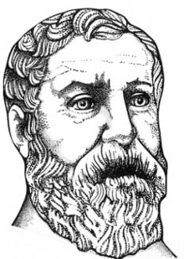
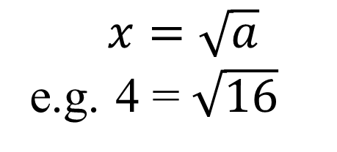
Introduction
In this week’s worksheet (#1) we are looking at implementing Heron’s Algorithm
In Java
Heron of Alexandria, aka Hero
10 CE to approximately 70 CE
A Greek mathematician and Engineer
Possibly Egyptian…
Developed an iterative algorithm for calculating the square root of a number…
$$x=\sqrt{a}$$
e.g. 4 = $\sqrt{16}$

Slide 4
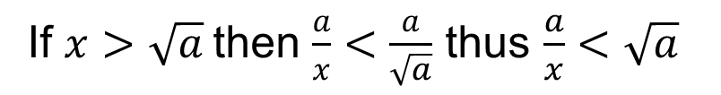
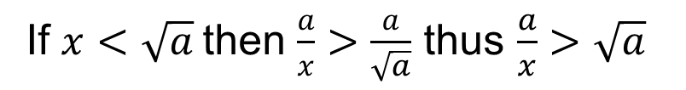

How it Works – Part 1
Firstly we note that x < a
The algorithm works by firstly guessing a value for the solution, anything will do, but Heron suggest x = a is a good start…
Given such as guess we “consider” in the mathematical sense x and a/x…
If $x<\sqrt{a}$then $\frac{a}{x}>\frac{a}{\sqrt{a}}$ thus $\frac{a}{x}>\sqrt{a}$
If $x>\sqrt{a}$then $\frac{a}{x}<\frac{a}{\sqrt{a}}$ thus $\frac{a}{x}<\sqrt{a}$
Thus whatever value we “guess” for x, we know that:
$Min\left(\frac{a}{x},x\right)<\sqrt{a}<Max\left(\frac{a}{x},x\right)$

Slide 5
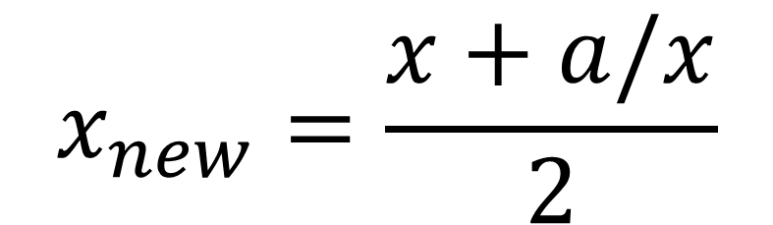
How it Works – Part 2
So we can repeatedly improve our estimate of x by iteratively choosing the mid point between the two limits…
$$x_{new}=\frac{x+a/x}{2}$$

Slide 6
How it Works – Part 3
Compute the square root of 16…
x₀ = 16
x₁ = (16 + 16/16) / 2 = 8.50
x₂ = (8.5 + 16 / 8.5) / 2 = 5.12
x₃ = (5.12 + 16 / 5.12) / 2 = 4.13
x₄ = (4.13 + 16 / 4.13) / 2 = 4.00

Slide 7
The Laboratory Worksheet
The purpose of the worksheet is to:
Get a Java program up and running!
Understand how Heron’s algorithm works
Get Heron’s algorithm working on a single example
Generate some (lots of) random data and test the code
Math.sqrt()
Time how long it takes to run a function of problem size (a)
How the labs are going to run…

Slide 8

Any Questions?
Via the chat…

